Slide 1
STdeconvolve: an application of latent Dirichlet allocation to deconvolve and visualize cell-types in multi-cellular spatial transcriptomics data
Brendan Miller
Post-doc in JEFworks Lab
Genomic Data Visualization
March 9th, 2022

Slide 2
Agenda
Biological motivation and spatial transcriptomics data
Deconvolution versus clustering
latent Dirichlet allocation
STdeconvolve
Hands on (if time)

Slide 3
The spatial organization of cell populations is functionally relevant
Example:
Tumor microenvironment
Understanding interactions between neoplastic and non-neoplastic cells can impact clinically relevant outcomes
Other examples you can think of?
Polidoro et al. 2020
Notes:
The primary motivation behind this project is that the spatial organization of cell populations is functionally relevant
One example is the disease setting of the tumor micro environment, where interactions between cancer cells and immune cells can affect the clinical outcome of patients.
Understanding these spatial interactions may lead to better treatment strategies.

Slide 4
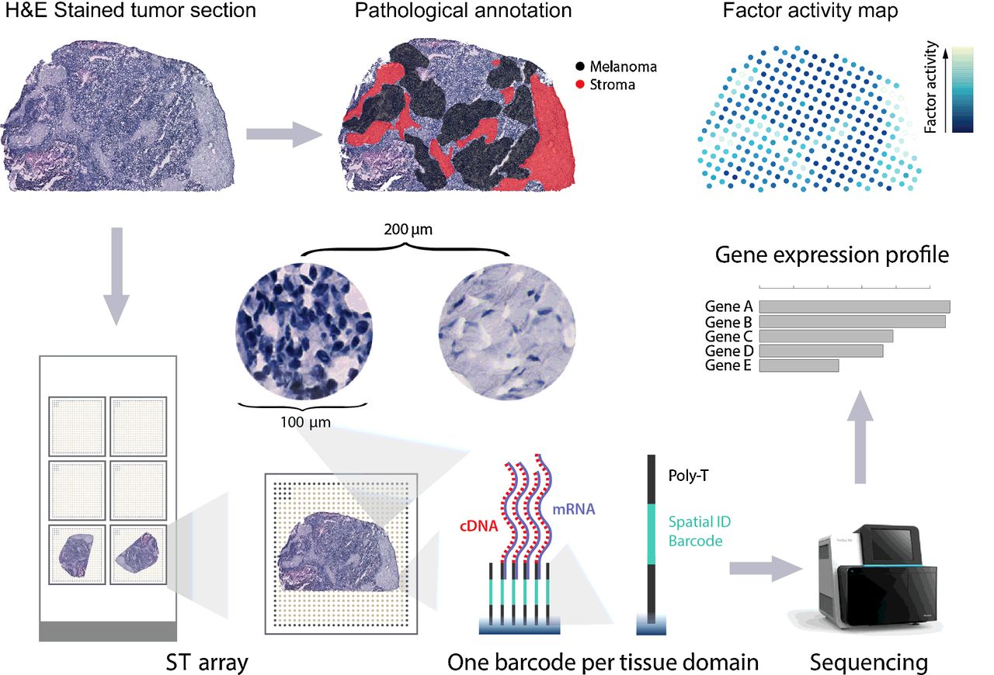
Spatially resolved transcriptomic profiling but at multi-cellular pixel resolution
in situ capture methods
10X Visium, DBiT-seq, Slide-seq, etc
Untargeted genome-wide mRNA profiling
How can we identify cell types?
Do we have confidence in the resolution?
Notes:
Is clustering sufficient?

Slide 5
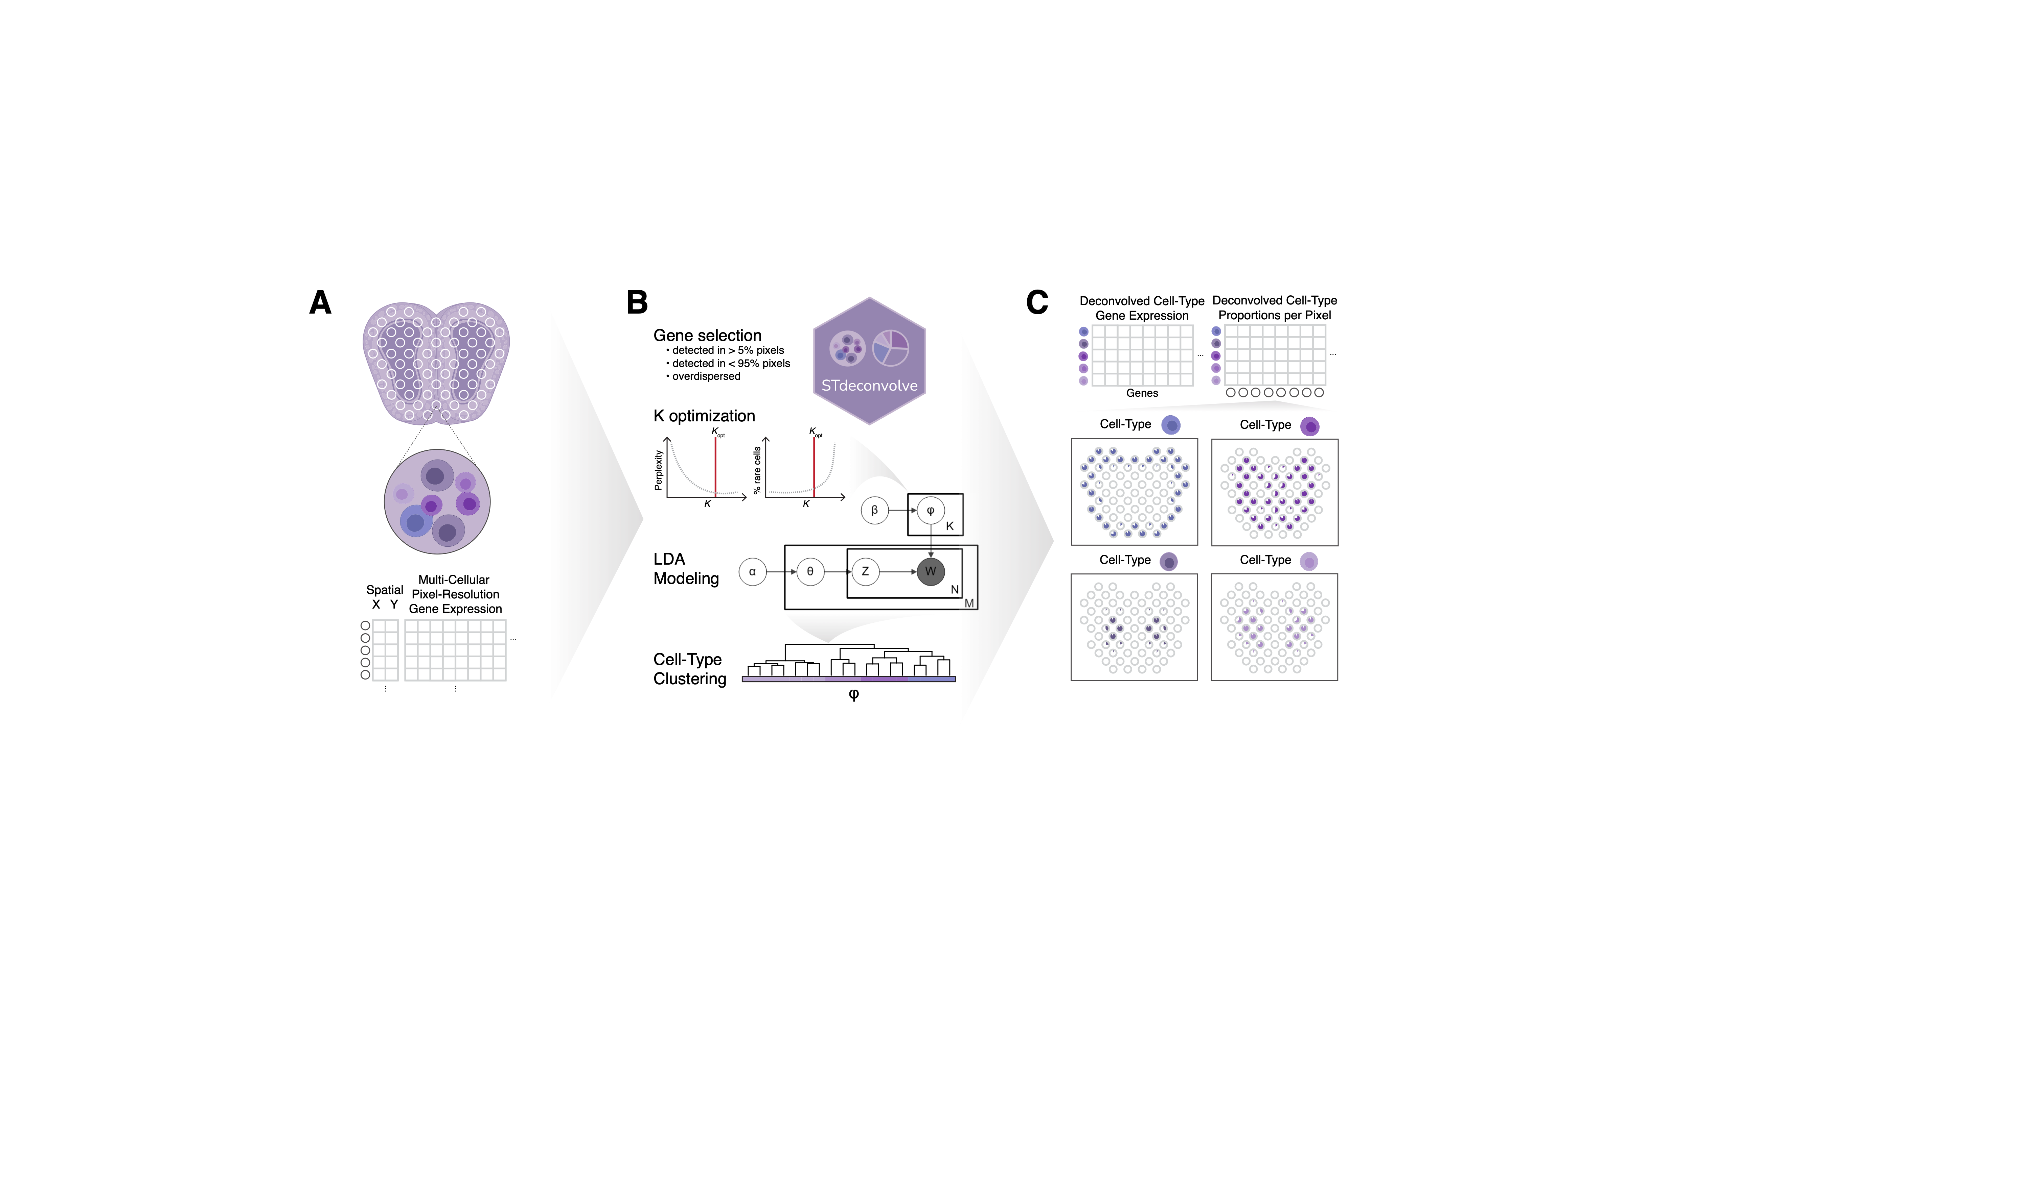
Spatially resolved transcriptomic profiling but at multi-cellular pixel resolution
in situ capture methods
10X Visium, DBiT-seq, Slide-seq, etc
Untargeted genome-wide mRNA profiling
Hinders the characterization of cell-type organizational patterns and spatial co-localization
?
Multi-cellular pixel resolution
What are the underlying cell-types?
Notes:
To explore the spatial organization of tissues, recent technological advancements have enabled spatially resolved transcriptomic profiling.
One flavor of these is:
in situ capture methods
These methods use mRNA capturing primers organized into arrays across a surface.
Primers in a given location or pixel have a unique spatial barcode.
Tissue can be overlaid on top these arrays and mRNAs captured and then sequenced at each location.
One output you can get are spatial expression patterns across the tissue.
But one limitation is that the size of the pixels typically contain more than 1 cell.
So the expression profile of each pixel represents the overall expression profile of the cell-mixture, and not individual cells, in the pixel.
This hinders the identification of cell-type spatial co-localization and organizational patterns.
One way to overcome this limitation is to try and figure out “what are the underlying latent cell-types?”

Slide 6
Deconvolution vs clustering
What is “clustering?”
What is “deconvolution?”

Slide 7
Deconvolution provides distinct insights compared to clustering analysis
Transcriptional clustering:
organize pixels into groups based on their overall transcriptional profiles
Deconvolution:
recover the constituent components of the overall transcriptional profile for each pixel
Notes:
If we assume that the pixels are mixtures of cell-types, then it would make more sense to try and break up the overall transcriptional profiles into mixtures or contributions of each individual cell-type.
Clustering pixels by their overall transcriptional profiles can certainly identify transcriptionally distinct spatial locations and patterns (which are themselves likely driven by the spatial organization of different cell-types). But we can’t figure out what the underlying components of each pixel are unless if we assume that each pixel is a pure mixture of a specific cell-type.

Slide 8
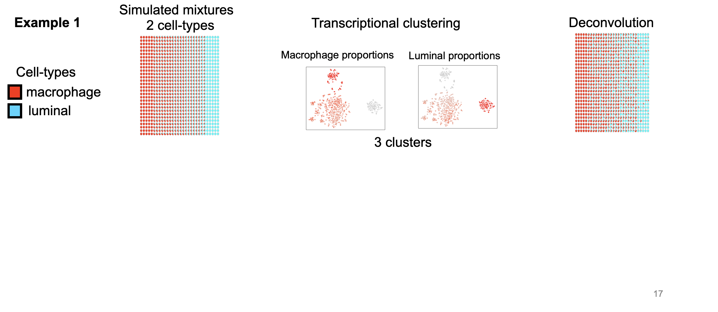
Deconvolution provides distinct insights compared to clustering analysis
Recovers the mixtures of 2 cell-types
Notes:
For example, in a set of spatial pixels, two cell types may be mixed together at different proportions. One can perform standard transcriptional clustering of these pixels and identify 3 distinct clusters.
One of these may represent pixels that are enriched for macrophage cells with their own distinct transcriptional profile,
another cluster may be pixels enriched with luminal cells and their own transcriptional profile,
and the third cluster of pixels may have a mixture of both, resulting in pixels with another distinct overall transcriptional profile.
In contrast to clustering, deconvolution attempts to recovers the underlying components of each transcriptional profile and indicates that the pixels are composed of 2 distinct cell-types at different proportions.
The information from transcriptional profiling is accurate, but unlike deconvolution, it is not giving you the cell-type composition of each pixel

Slide 9
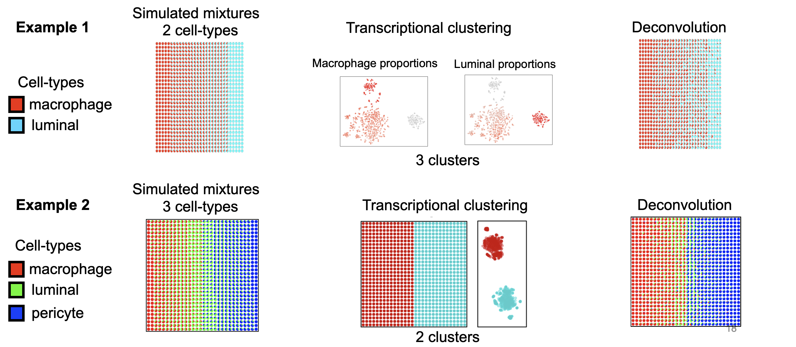
Deconvolution provides distinct insights compared to clustering analysis
Notes:
The opposite situation may also occur. Here there are 3 cell-types mixed together, but transcriptional clustering of the pixels results in only 2 distinct clusters. Perhaps two cell-types are transcriptionally distinct that pixels that contain one or the other are placed into separate transcriptional clusters, but other cell-types that are present remain undetected.
Conversely, deconvolution can recover the cell-type proportions of all 3 cell-types in the pixels.

Slide 10
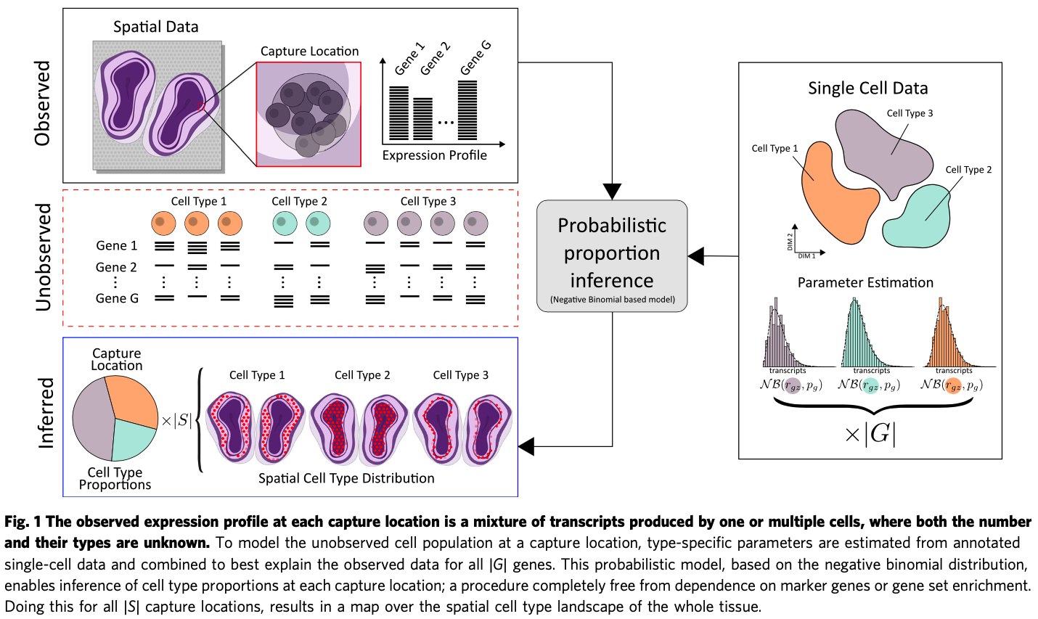
General idea to deconvolve cell-types in multi-cellular pixels
Is there anything we can use to help identify the latent, unobserved variables?

Slide 11
One strategy: could use a reference to help infer cell-types

Slide 12
Limitations of reference-dependent methods

Slide 13
Limitations of reference-dependent methods
Missing cell types in reference – what would happen?
Also different cell states or perturbations
Why? References can be built from of healthy tissue but applied to disease tissue
Some cell-types are hard to capture and require protocol modifications
Technical differences between single-cell RNA-seq and ST data
References assume the cells have been clustered properly
Maybe there isn’t a reference that exists for the tissue type that is being profiled

Slide 14
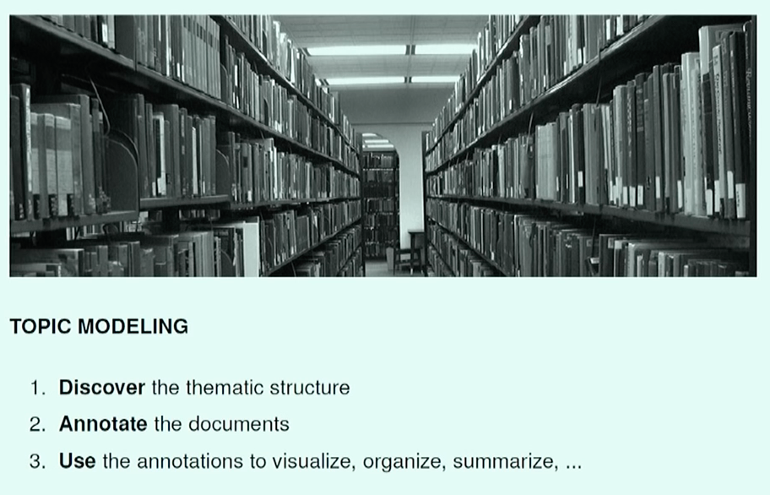
Enter Topic Models
Prof. David Blei - Probabilistic Topic Models and User Behavior

Slide 15
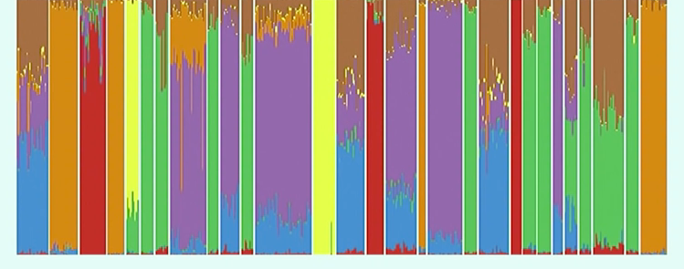
Enter Topic Models
Genetic signatures
proportion
people
Words = SNPs
Topics = population ancestry proportions
Documents = people
Gopalan 2016 Nat Genetics
Prof. David Blei - Probabilistic Topic Models and User Behavior

Slide 16
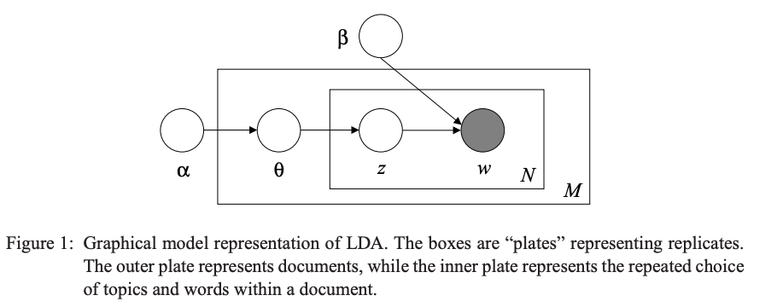
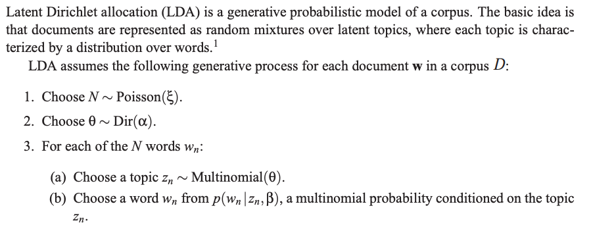
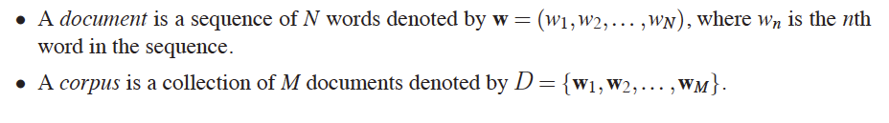
An alternative reference-free approach to infer latent cell-types
latent Dirichlet allocation
A model to formally describe the probabilistic way in which a set of data arises
θ = multinomial distribution over topics (i.e., document topic mixture)
β = matrix of topic word probabilities (i.e., topic distributions over words)
z = topic assignment for the w_{n}th word
α = Dirichlet distribution from which θ’s are drawn
Blei et al 2003
Notes:
The basic idea is that documents are represented as random mixtures over latent topics, where each topic is characterized by a distribution over words.

Slide 17
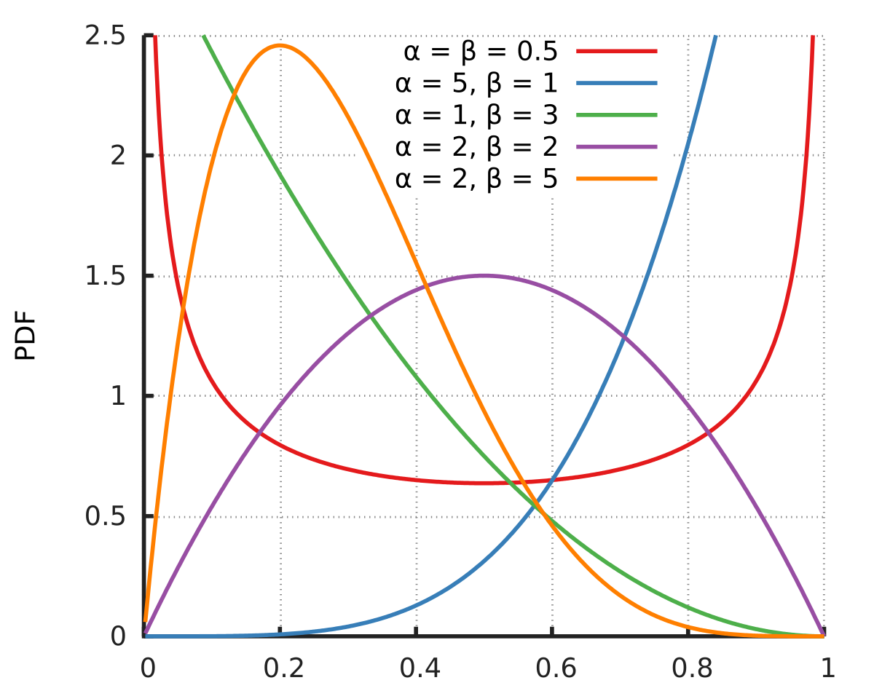
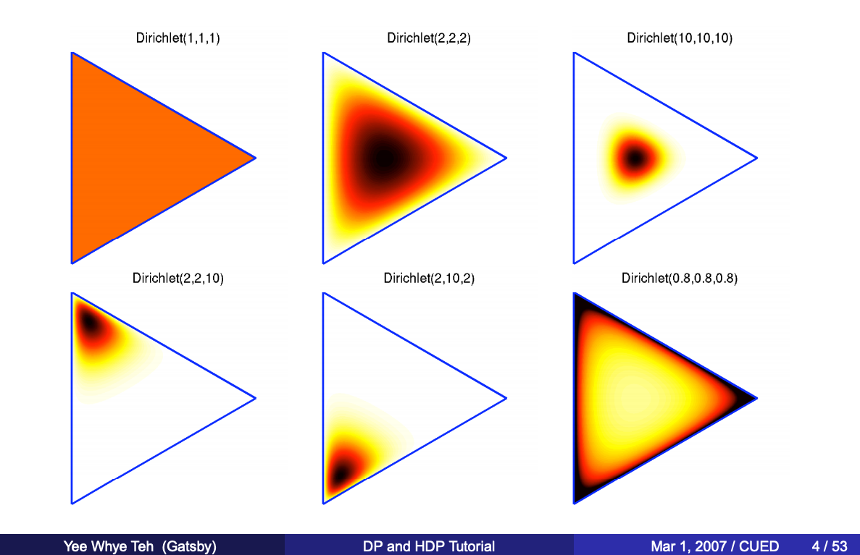
Dirichlet distributions
Multivariate version of a beta distribution.
Instead of two parameters controlling shape of distribution, there are 3+
Draws from this distribution are multinomials of probabilities that sum to 1
Notes:
“Distribution of distributions”

Slide 18
Dirichlet distribution demo

Slide 19
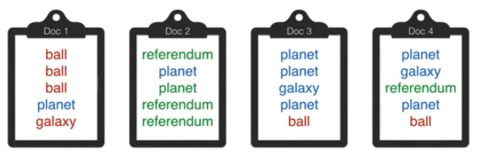
LDA simple example
4 words and 3 topics (red, blue, green).
We can infer that maybe red = “sports”, blue = “science”, green = “politics”
Notice that some words are in multiple topics,
but each topic is enriched in certain words wrt the other topics
Can we build a model to formally describe the probabilistic way in which these documents were generated?

Slide 20
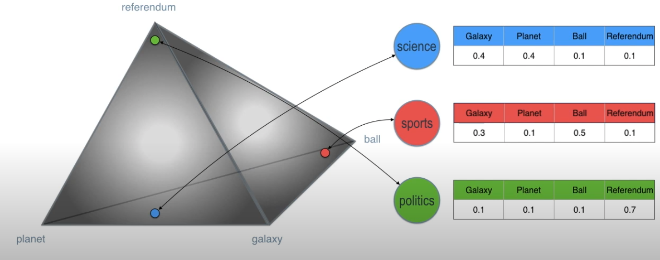
LDA simple example
β = matrix of topic word probabilities (i.e., Distribution of words in each topic)

Slide 21
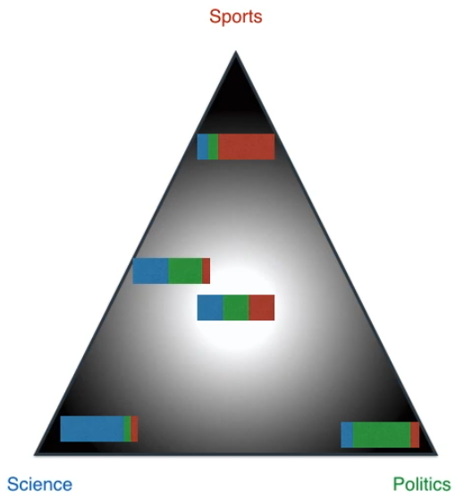
LDA simple example
α = Dirichlet distribution from which θ’s are drawn
θ = multinomial distribution over topics (i.e., document topic mixtures)
Distribution of topics in each document

Slide 22
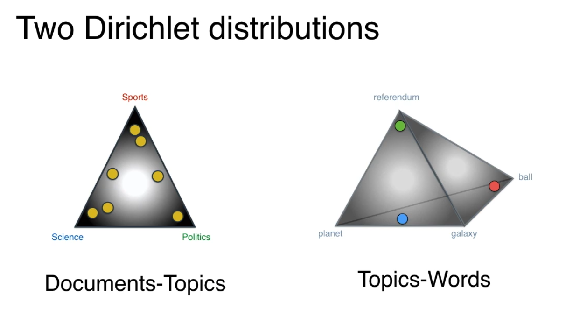
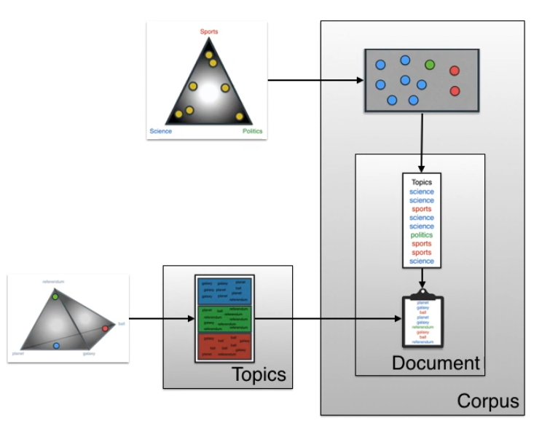
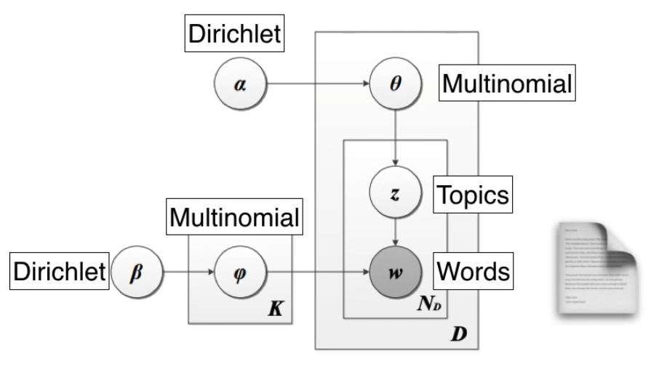
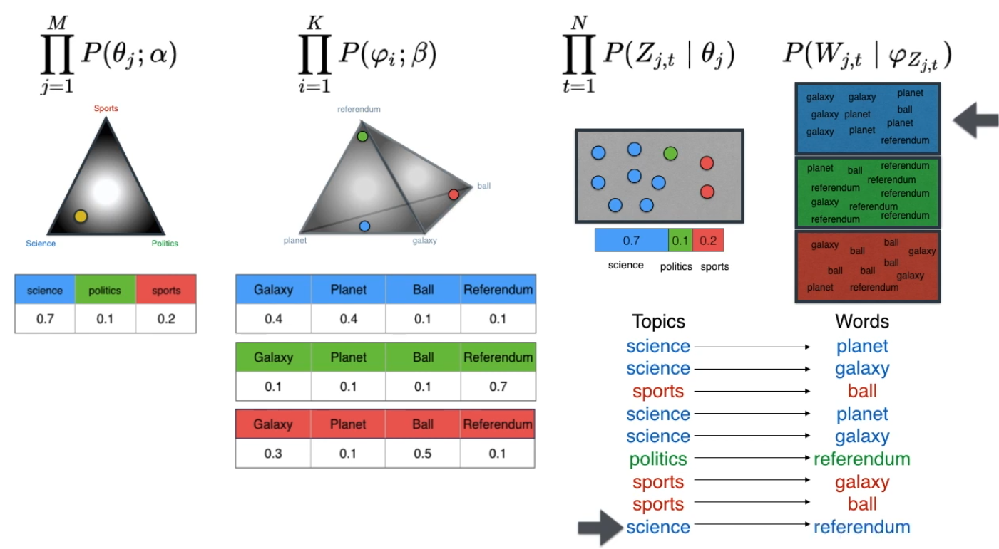
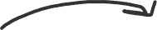
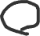
LDA simple example
Topic mixture
topic assignment
w
words
documents
K = number of topics to model
science
politics
sports
Notes:
Plate schematic
Dirichlet distribution: “multivariate beta distribution”. Instead of 2 parameters, it has 3+ parameters.
Dir( a1, a2, a3, etc) to set the shape of the distribution.
Then take draws from the distribution that are probability vectors that sum to 1.

Slide 23
LDA simple example
This assumes we know the structure of the data (latent parameters), but in reality, we do not
Topic mixture
topic assignment
w
words
documents
K = number of topics to model
science
politics
sports
Notes:
Plate schematic
Dirichlet distribution: “multivariate beta distribution”. Instead of 2 parameters, it has 3+ parameters.
Dir( a1, a2, a3, etc) to set the shape of the distribution.
Then take draws from the distribution that are probability vectors that sum to 1.

Slide 24
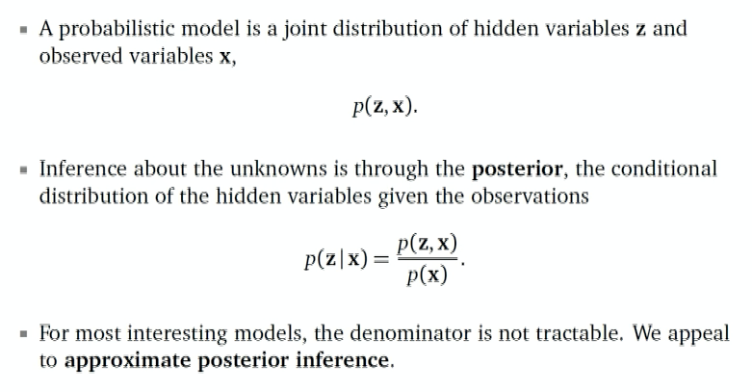
How do we infer the latent parameters?
Prof. David Blei - Variational Inference: Foundations and Innovations
Notes:
We want to uncover the latent structure of the data by computing the posterior, then use that structure to perform our task, like visualize cell-type proportions in pixels…
Joint – probability of 2 events happening together

Slide 25
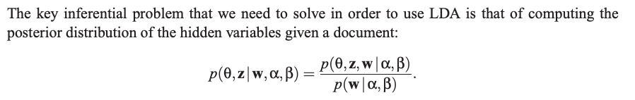
How do we infer the latent parameters?
The central inferential problem for LDA is determining the posterior distribution of the latent variables.
For a given document:
Joint probability
Posterior probability
Marginal probability (evidence)
Prof. David Blei - Variational Inference: Foundations and Innovations
Notes:
We want to uncover the latent structure of the data by computing the posterior, then use that structure to perform our task, like visualize cell-type proportions in pixels…
Note that this all assumes we know α and β.
But how do we know them? We estimate them assuming we know the variational parameters that are determined during the EM algorithm. Use the parameters to update alpha and beta.
We compute the variational parameters for every document. So we do end up with theta for every document
They are estimated given the current hidden variable distribution estimates in variational EM

Slide 26
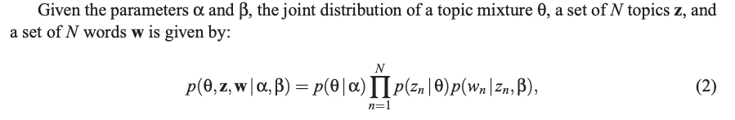
How do we infer the latent parameters?
Given the parameters α and β, the joint distribution of a topic mixture θ, a set of N topics z, and a set of N words w is given by:

Slide 27
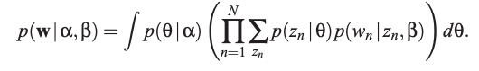
How do we infer the latent parameters?
Given the parameters α and β, the joint distribution of a topic mixture θ, a set of N topics z, and a set of N words w is given by:
We marginalize over θ and z in order to obtain the denominator (often referred to as the evidence)
Notes:
Marginalisation is a method that requires summing over the possible values of one variable to determine the marginal contribution of another.
Marginal probability is the probability of an event irrespective of the outcome of another variable.
Marginalisation is a method that requires summing over the possible values of one variable to determine the marginal contribution of another

Slide 28
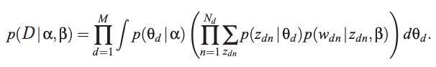
How do we infer the latent parameters?
Given the parameters α and β, the joint distribution of a topic mixture θ, a set of N topics z, and a set of N words w is given by:
We marginalize over θ and z in order to obtain the denominator (often referred to as the evidence)
Note:
Taking the product of the marginal probabilities of single documents, we obtain the probability of a corpus:
Notes:
Marginalisation is a method that requires summing over the possible values of one variable to determine the marginal contribution of another.
Marginal probability is the probability of an event irrespective of the outcome of another variable.
Marginalisation is a method that requires summing over the possible values of one variable to determine the marginal contribution of another

Slide 29
How do we infer the latent parameters?
Problem: coupling between α and β makes this intractable (this happens a lot in Bayesian inference)
So estimate the parameters instead (many ways to do this)
Gibbs sampling, variational expectation-maximization, etc.
Fortunately, lots of software packages implement some flavor of these posterior estimation approaches 😁
Notes:
Note that this all assumes we know α and β.
But how do we know them? We estimate them assuming we know the variational parameters that are determined during the EM algorithm. Use the parameters to update alpha and beta.
We compute the variational parameters for every document. So we do end up with theta for every document
They are estimated given the current hidden variable distribution estimates in variational EM

Slide 30
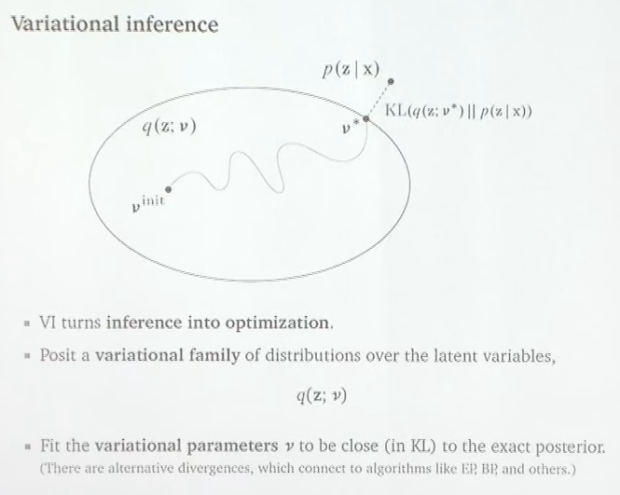
Prof. David Blei - Variational Inference: Foundations and Innovations
Notes:
Variational family of distributions q of the latent varaibles z that is indexed by v.
Every point in elipse is a different distribution over z
Optimize parameter v until you get a distribution q that is as close as possible (measured by some sort of divergence (KL in this case))
Then q(z; v) becomes a proxy for p(z)

Slide 31
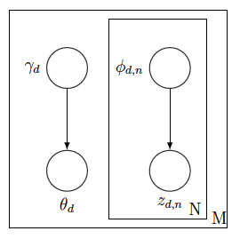
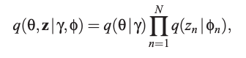
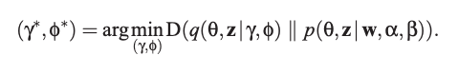
Problematic coupling between α and β arises due to edges between α and β, z, and w. Drop these edges and w node
Dirichlet parameter γ and the multinomial parameters (φ1,...,φN) are now free variational parameters
Optimizing values of the variational parameters are found by minimizing the Kullback Leibler (KL) divergence between the variational distribution and the true posterior p(θ, z|w,α,β)

Slide 32
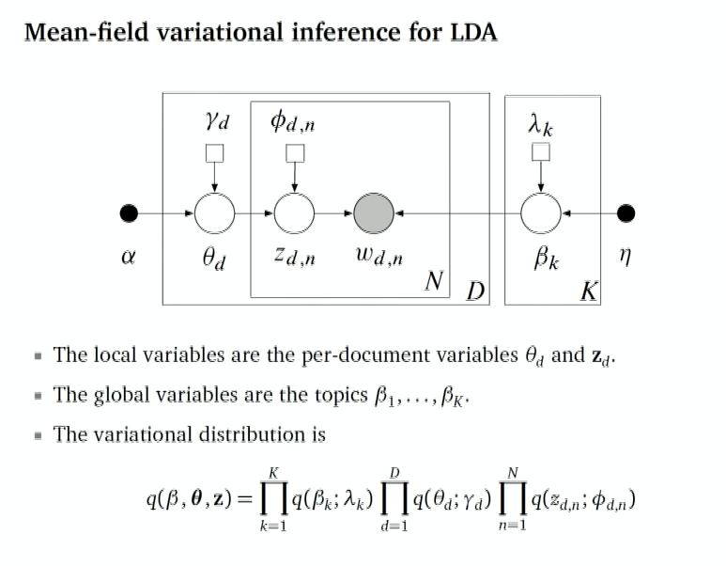
Prof. David Blei - Variational Inference: Foundations and Innovations

Slide 33
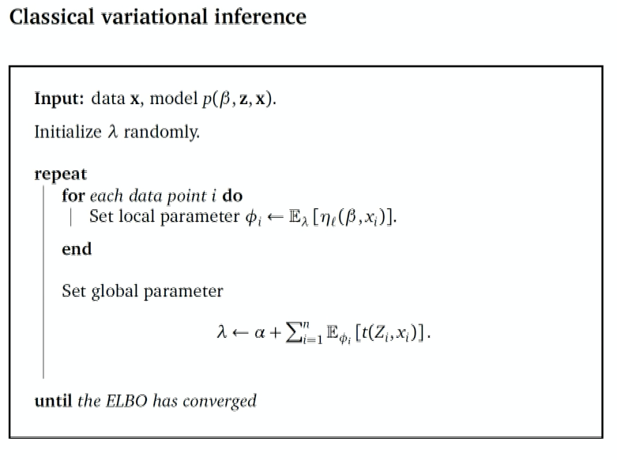
Notes:
March through every document and understand how it represents topics (phi)
Use those to update the topics to something more meaningful with lambda
Then repeat

Slide 34
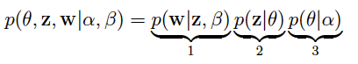
Why does this even work?
Joint distribution, our model:
What configurations of latent variables make this large?
In other words, what characteristics of β, θ, and α lead to large probabilities?
Notes:
The simple and straightforward answer is co-occurance. LDA extracts clusters of co-occurring words to form topics. The three factors form an interesting dynamic: (1) implies that having sparsely distributed topics can result in a high probability for a document, where the ideal way to form the sparse components is to make them non-overlapping clusters of co-occurring words in diﬀerent documents (why is this?); (2) encourages a sparse θ matrix so that the probability of choosing a given z value will be large, e.g. θ = (0.25, 0.25, 0.25, 0.25) would yield smaller probabilities than θ = (0.5, 0.5, 0, 0) . In other words, (2) penalizes documents for having too many possible topics. (3) again penalizes using a large number of possible topics for a given document—small α values yield sparse θs. In summary: (1) wants to form sparse, segregated word clusters, (2) and (3) want to give a small number of possible topics for each document. But if we only have a few topics to choose from and each topic has a small number of non-zero word probabilities, then we surely better form meaningful clusters that could represent a diverse number of documents. How should we do this you ask? Form clusters of co-occurring terms, which is largely what LDA accomplishes. But while the joint distribution encourages a small number of topics with small meaningful (co-occurring) topics, the data itself needs a larger number of topics in order to assign small “topic clusters” to the data. So, as desired, we have a push and pull factor between the joint distribution and the actual data in determining the assignment of topics.

Slide 35
Why does this even work?
Joint distribution, our model:
What configurations of latent variables make this large?
If β is a sparse matrix, then this will increase the probability of certain words
(The β values for a given topic must sum to one so the more terms we assign to the topic, the smaller their probabilities)
implies that making θ have concentrated components will increase the probability.
This implies that using a small α will increase the probability
Notes:
The simple and straightforward answer is co-occurance. LDA extracts clusters of co-occurring words to form topics. The three factors form an interesting dynamic: (1) implies that having sparsely distributed topics can result in a high probability for a document, where the ideal way to form the sparse components is to make them non-overlapping clusters of co-occurring words in diﬀerent documents (why is this?); (2) encourages a sparse θ matrix so that the probability of choosing a given z value will be large, e.g. θ = (0.25, 0.25, 0.25, 0.25) would yield smaller probabilities than θ = (0.5, 0.5, 0, 0) . In other words, (2) penalizes documents for having too many possible topics. (3) again penalizes using a large number of possible topics for a given document—small α values yield sparse θs. In summary: (1) wants to form sparse, segregated word clusters, (2) and (3) want to give a small number of possible topics for each document. But if we only have a few topics to choose from and each topic has a small number of non-zero word probabilities, then we surely better form meaningful clusters that could represent a diverse number of documents. How should we do this you ask? Form clusters of co-occurring terms, which is largely what LDA accomplishes. But while the joint distribution encourages a small number of topics with small meaningful (co-occurring) topics, the data itself needs a larger number of topics in order to assign small “topic clusters” to the data. So, as desired, we have a push and pull factor between the joint distribution and the actual data in determining the assignment of topics.

Slide 36
Why does this even work?
(1) wants to form sparse, segregated word clusters
Joint distribution, our model:
(2) and (3) want to give a small number of possible topics for each document
What configurations of latent variables make this large?
How can we do this?
- In each topic, assign high probability to just a few words (sparse β)
- In each document, allocate its words to just a few topics (sparse θ), thus sparse α
These are at odds:
If a document has one topic, then all its words would be assigned to that topic
But if each topic described by just a few words, then each document needs to contain many topics to describe all its words
Trade-off: find groups of non-overlapping, tightly co-occurring words in documents
(similar groups of words that occur together in some documents but not others)
Notes:
The simple and straightforward answer is co-occurance. LDA extracts clusters of co-occurring words to form topics. The three factors form an interesting dynamic: (1) implies that having sparsely distributed topics can result in a high probability for a document, where the ideal way to form the sparse components is to make them non-overlapping clusters of co-occurring words in diﬀerent documents (why is this?); (2) encourages a sparse θ matrix so that the probability of choosing a given z value will be large, e.g. θ = (0.25, 0.25, 0.25, 0.25) would yield smaller probabilities than θ = (0.5, 0.5, 0, 0) . In other words, (2) penalizes documents for having too many possible topics. (3) again penalizes using a large number of possible topics for a given document—small α values yield sparse θs. In summary: (1) wants to form sparse, segregated word clusters, (2) and (3) want to give a small number of possible topics for each document. But if we only have a few topics to choose from and each topic has a small number of non-zero word probabilities, then we surely better form meaningful clusters that could represent a diverse number of documents. How should we do this you ask? Form clusters of co-occurring terms, which is largely what LDA accomplishes. But while the joint distribution encourages a small number of topics with small meaningful (co-occurring) topics, the data itself needs a larger number of topics in order to assign small “topic clusters” to the data. So, as desired, we have a push and pull factor between the joint distribution and the actual data in determining the assignment of topics.

Slide 37
Back to the biological problem at hand
LDA is a reference-free approach to predict topic mixtures in documents and topic distributions of words

Slide 38
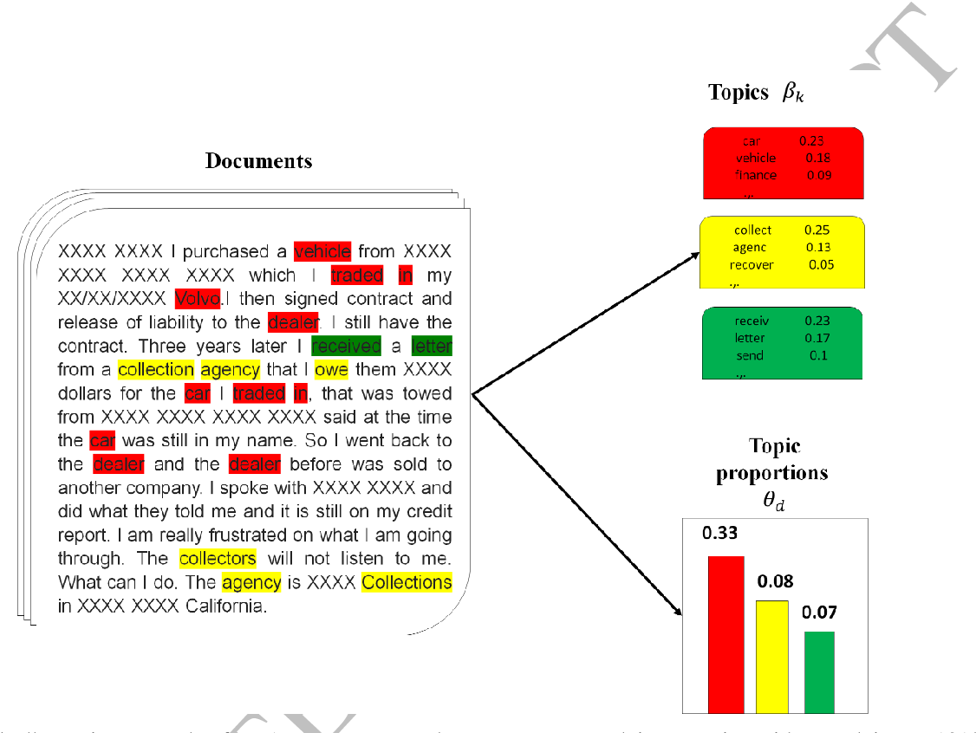
STdeconvolve is a reference-free approach that builds upon latent Dirichlet allocation (LDA)
LDA assumptions
Documents are mixtures of topics
Can we model biological data this way?
Any similarities?
Use word frequencies to infer the latent topics
Topics are distributions over words
Notes:
To do this, we developed STdeconvolve, a reference-free approach, that borrows ideas from Natural Language Processing, specifically Latent Dirichlet Allocation.
The purpose of LDA is to identify latent topics in documents.
The basic idea is that documents are collections of words. But documents can also be represented as mixtures of underlying topics.
Each topic itself is a distribution over words.
So one should be able to uncover the latent topics by measuring the frequency and occurrence of different words in the documents.

Slide 39
STdeconvolve is a reference-free approach that builds upon latent Dirichlet allocation (LDA)
LDA assumptions
Spatial transcriptomics assumptions
Documents are mixtures of topics
Pixels are mixtures of cell-types
pixel
Use word frequencies to infer the latent topics
Use gene counts to infer the latent cell-types
Topics are distributions over words
Cell-types are distributions over genes
Notes:
Likewise, we can apply the same ideas to ST data.
Each pixel is a mixture of cell-types
And each cell-type is a distribution over genes, or effectively a transcriptional profile.
We can then look at the gene counts in each pixel to uncover the latent cell-type proportions.
LDA is a generative model. Which means it generates a set of pixels, and we iteratively finetune parameters until the generative set of pixels closely resembles the real data. After, we can pull out the parameters of interest, like the beta and theta distributions.
Mixed membership: data are grouped, like in documents.
All groups share the same mixture components, or topics.

Slide 40
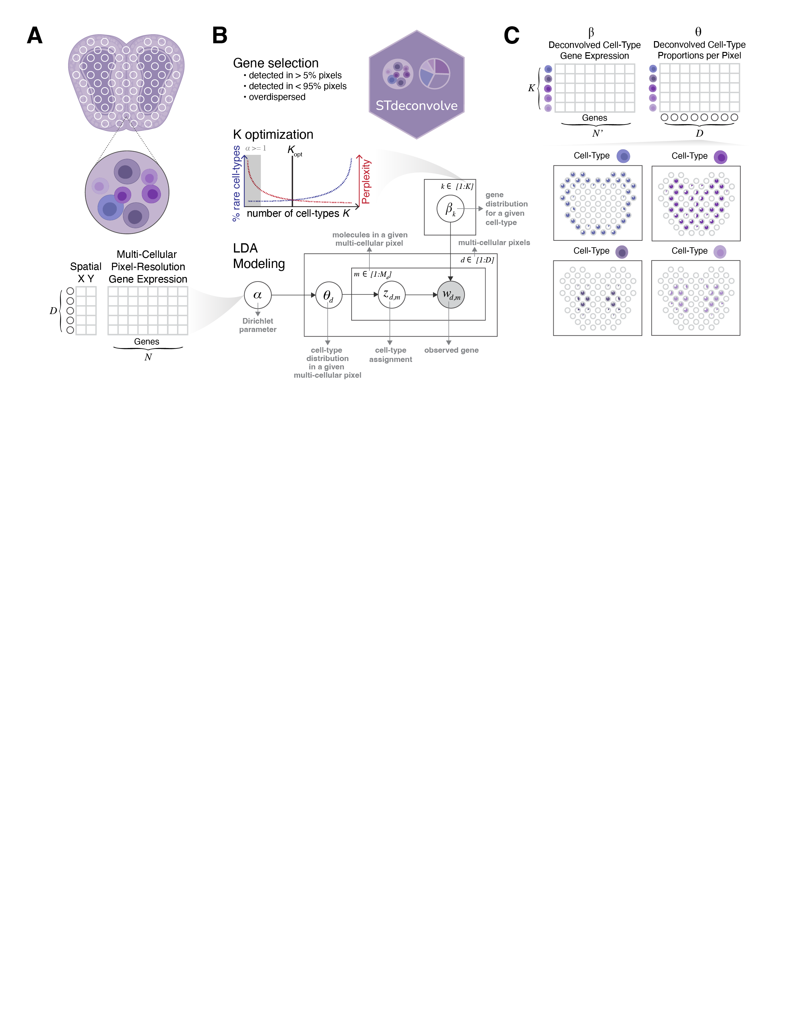
STdeconvolve workflow
Output:
Input:
Pixels:
Visualize!
Notes:
Here is the general overview of the workflow of STdeconvolve.
We start with an input matrix that contains the gene counts for each pixel.
We feature select for informative genes, and we also need to choose the number of cell-types or K topics to be deconvolved a priori.
STdeconvolve outputs two matrices.
The first is the deconvolved cell-type proportions in each pixel (the distributions over cell-types for each pixel).
But what’s also cool is that STdeconvolve returns the deconvolved cell-type transcriptional profiles as well (the distributions over genes for each cell-type)
Overdispersion – greater variance than would be expected based on a given model. For gene expression, connected to magnitude. So genes with greater magnitude also have higher variability.

Slide 41
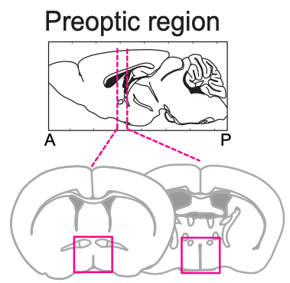
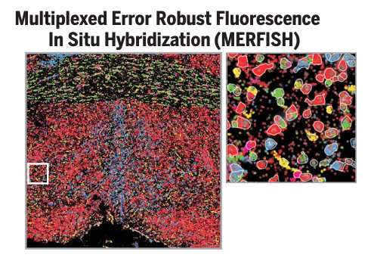
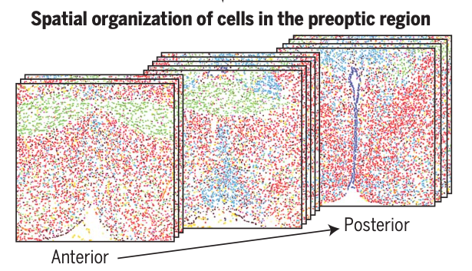
Proof of concept: demonstrate performance using a simulated ST dataset with known ground truth
MERFISH MPOA data ground truth dataset
Mouse hypothalamic medial preoptic region
(MPOA)
Annotations of individual cells and their spatial information
Moffit et al. 2018
Notes:
To assess STdeconvolve as a proof of concept, we generated a simulated ST dataset with a known cell-type proportions and transcriptional profiles to act as ground truths.
We utilized MERFISH data generated from the mouse hypothalamic medial preoptic region.
MERFISH is a single cell-resolution targeted transcriptional profiling technique.
From this dataset we have annotations of individual cells, and their spatial locations.

Slide 42
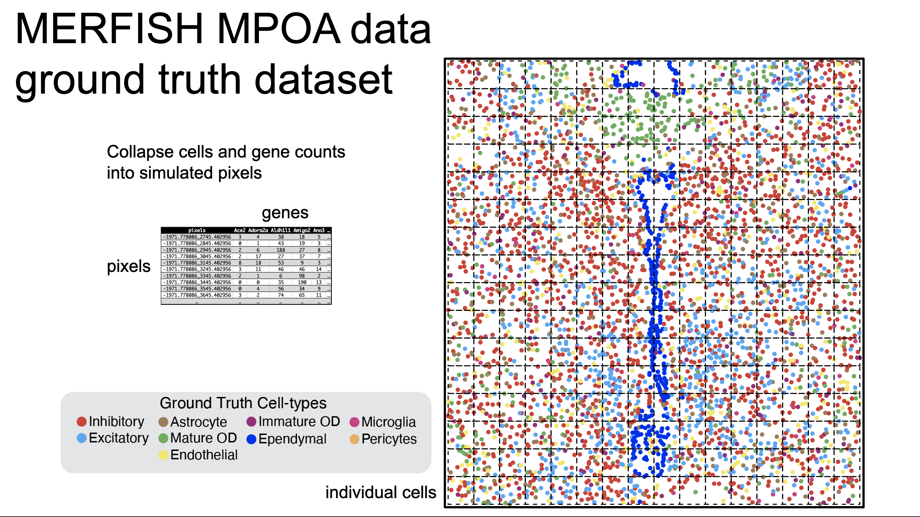
Notes:
Here is an example of the annotated MERFISH data.
Points are locations of individual cells colored by their annotated ground truth cell-type.
To create simulated ST data, I can segment this into simulated pixels, in which I collapse the gene counts for cells with a given pixel.
After combining cells, I also know the proportions of each cell-type in each of my simulated pixels.

Slide 43
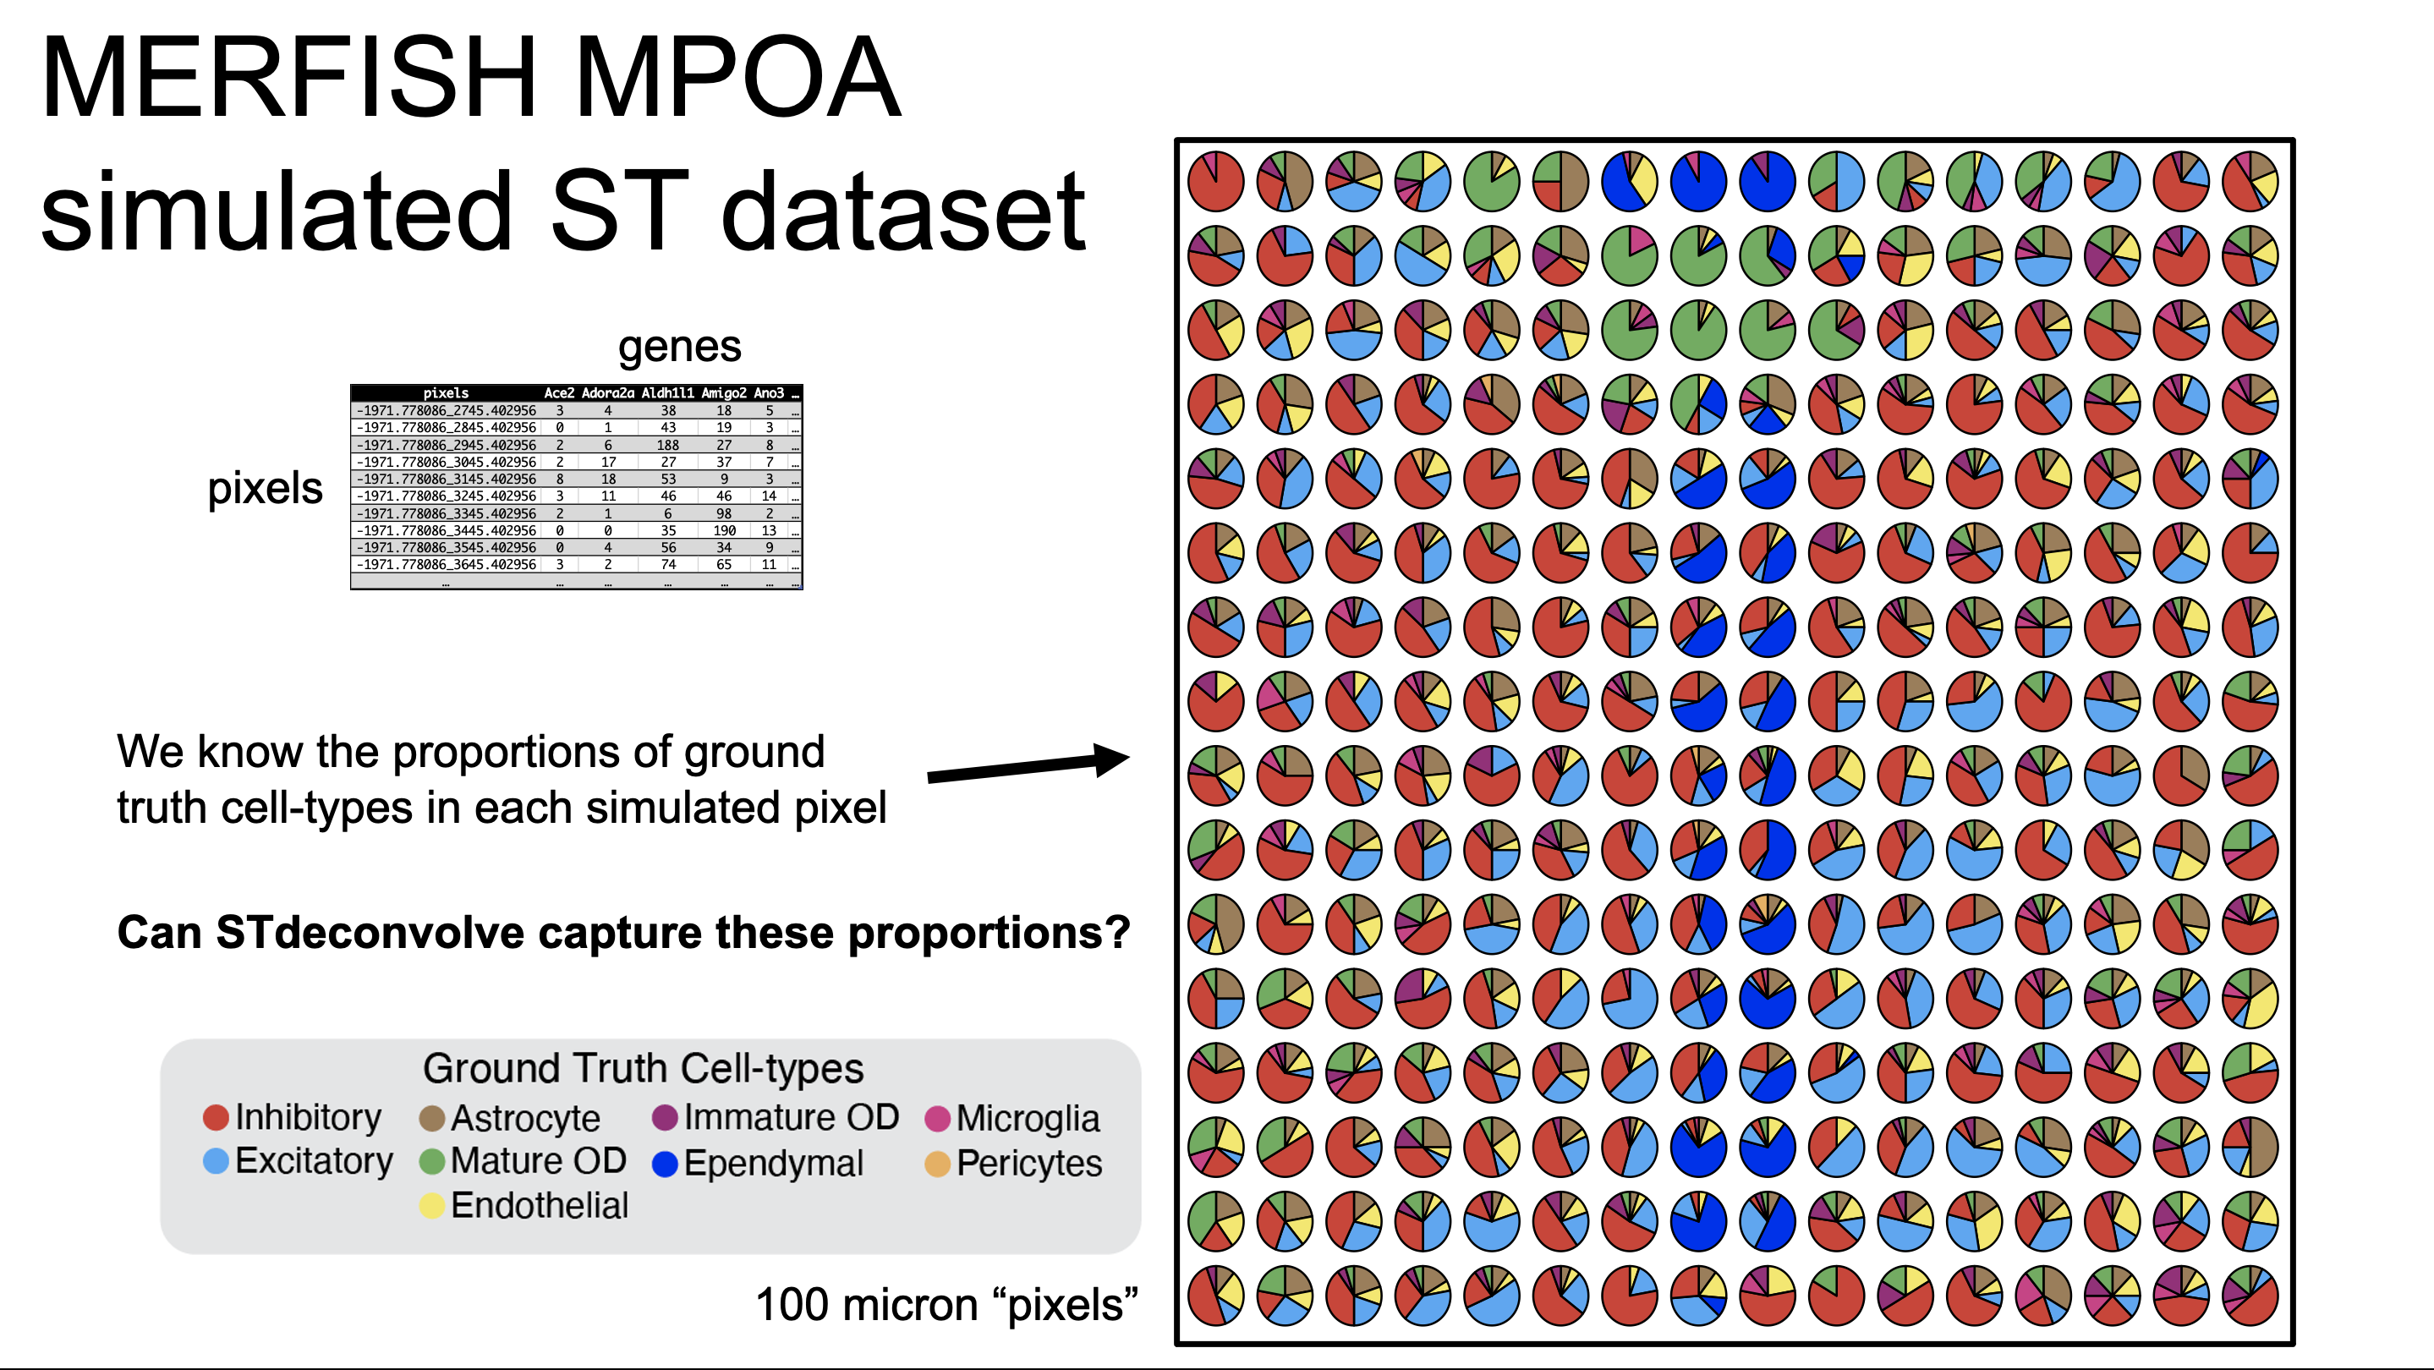
Notes:
This looks something like this, where each pie chart represents the proportions of each cell-type in each of the simulated pixels
With my simulated ST data I can now ask if STdeconvolve is able to recover the cell type proportions and return something similar.

Slide 44
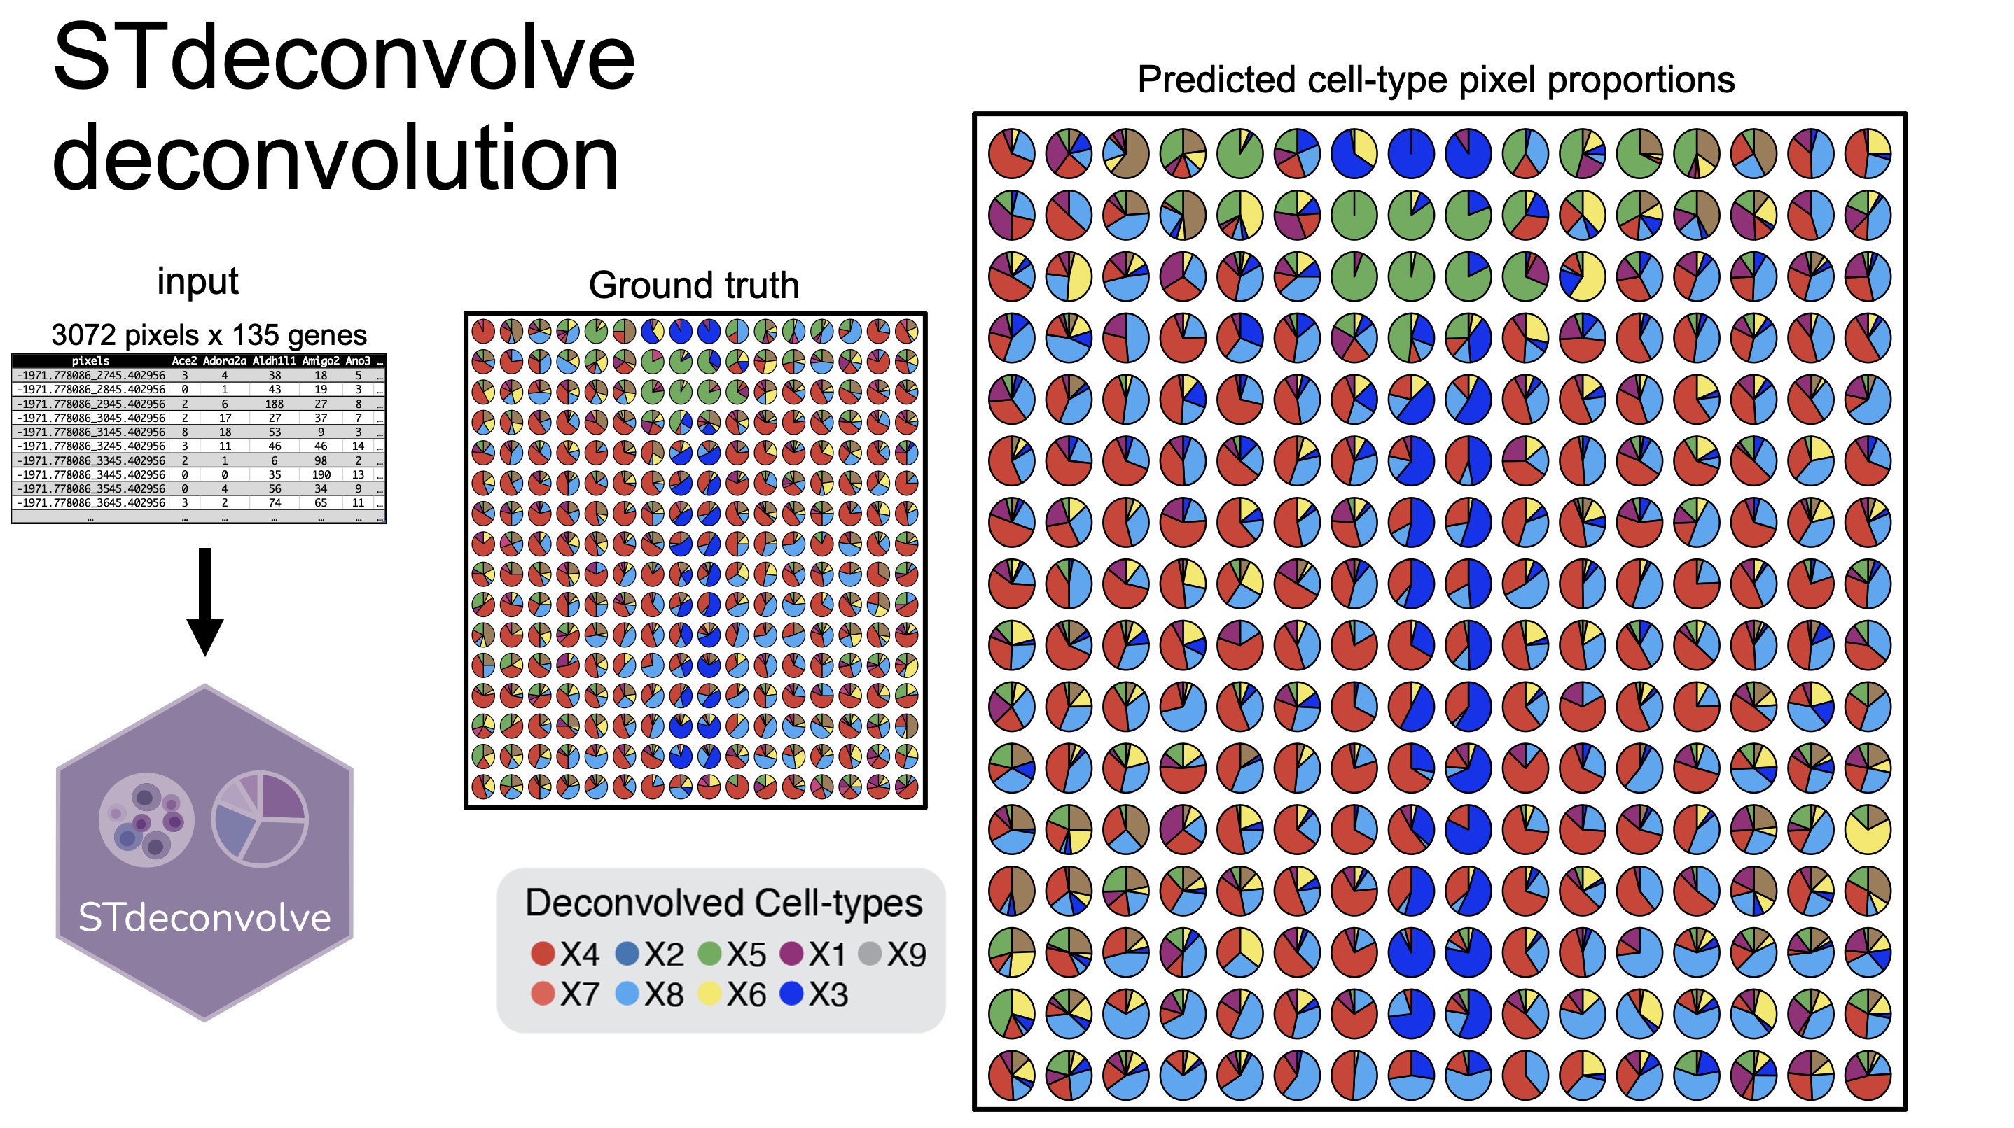
Notes:
Here is the STdeconvolve predicted cell-type proportions, with the ground truth for reference.
Encouragingly, STdeconvolve does a pretty good job deconvolving the underlying the cell-types at each simulated pixel from the combined gene counts.

Slide 45
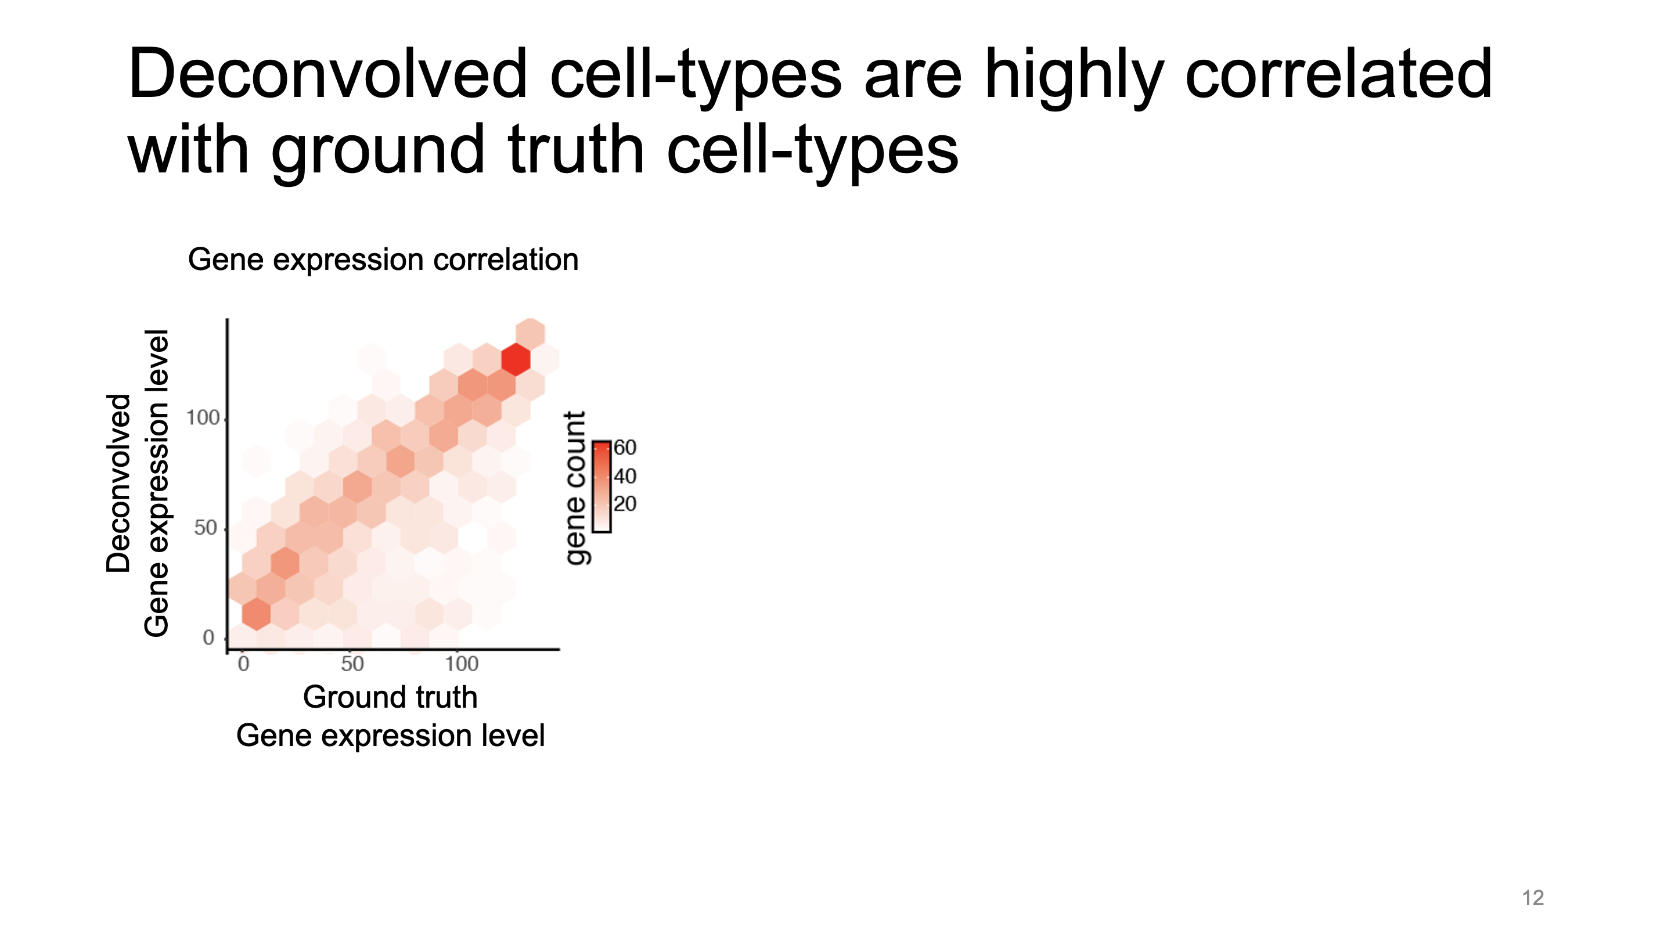
Notes:
I can also quantify this.
First, recall that STdeconvolve not only deconvolved the cell-type proportions, but also predicts the gene expression profiles for the cell-types.
Here I show the gene expression levels of the genes for all of the deconvolved cell-types and ground truth cell-types, and they correlate nicely.

Slide 46
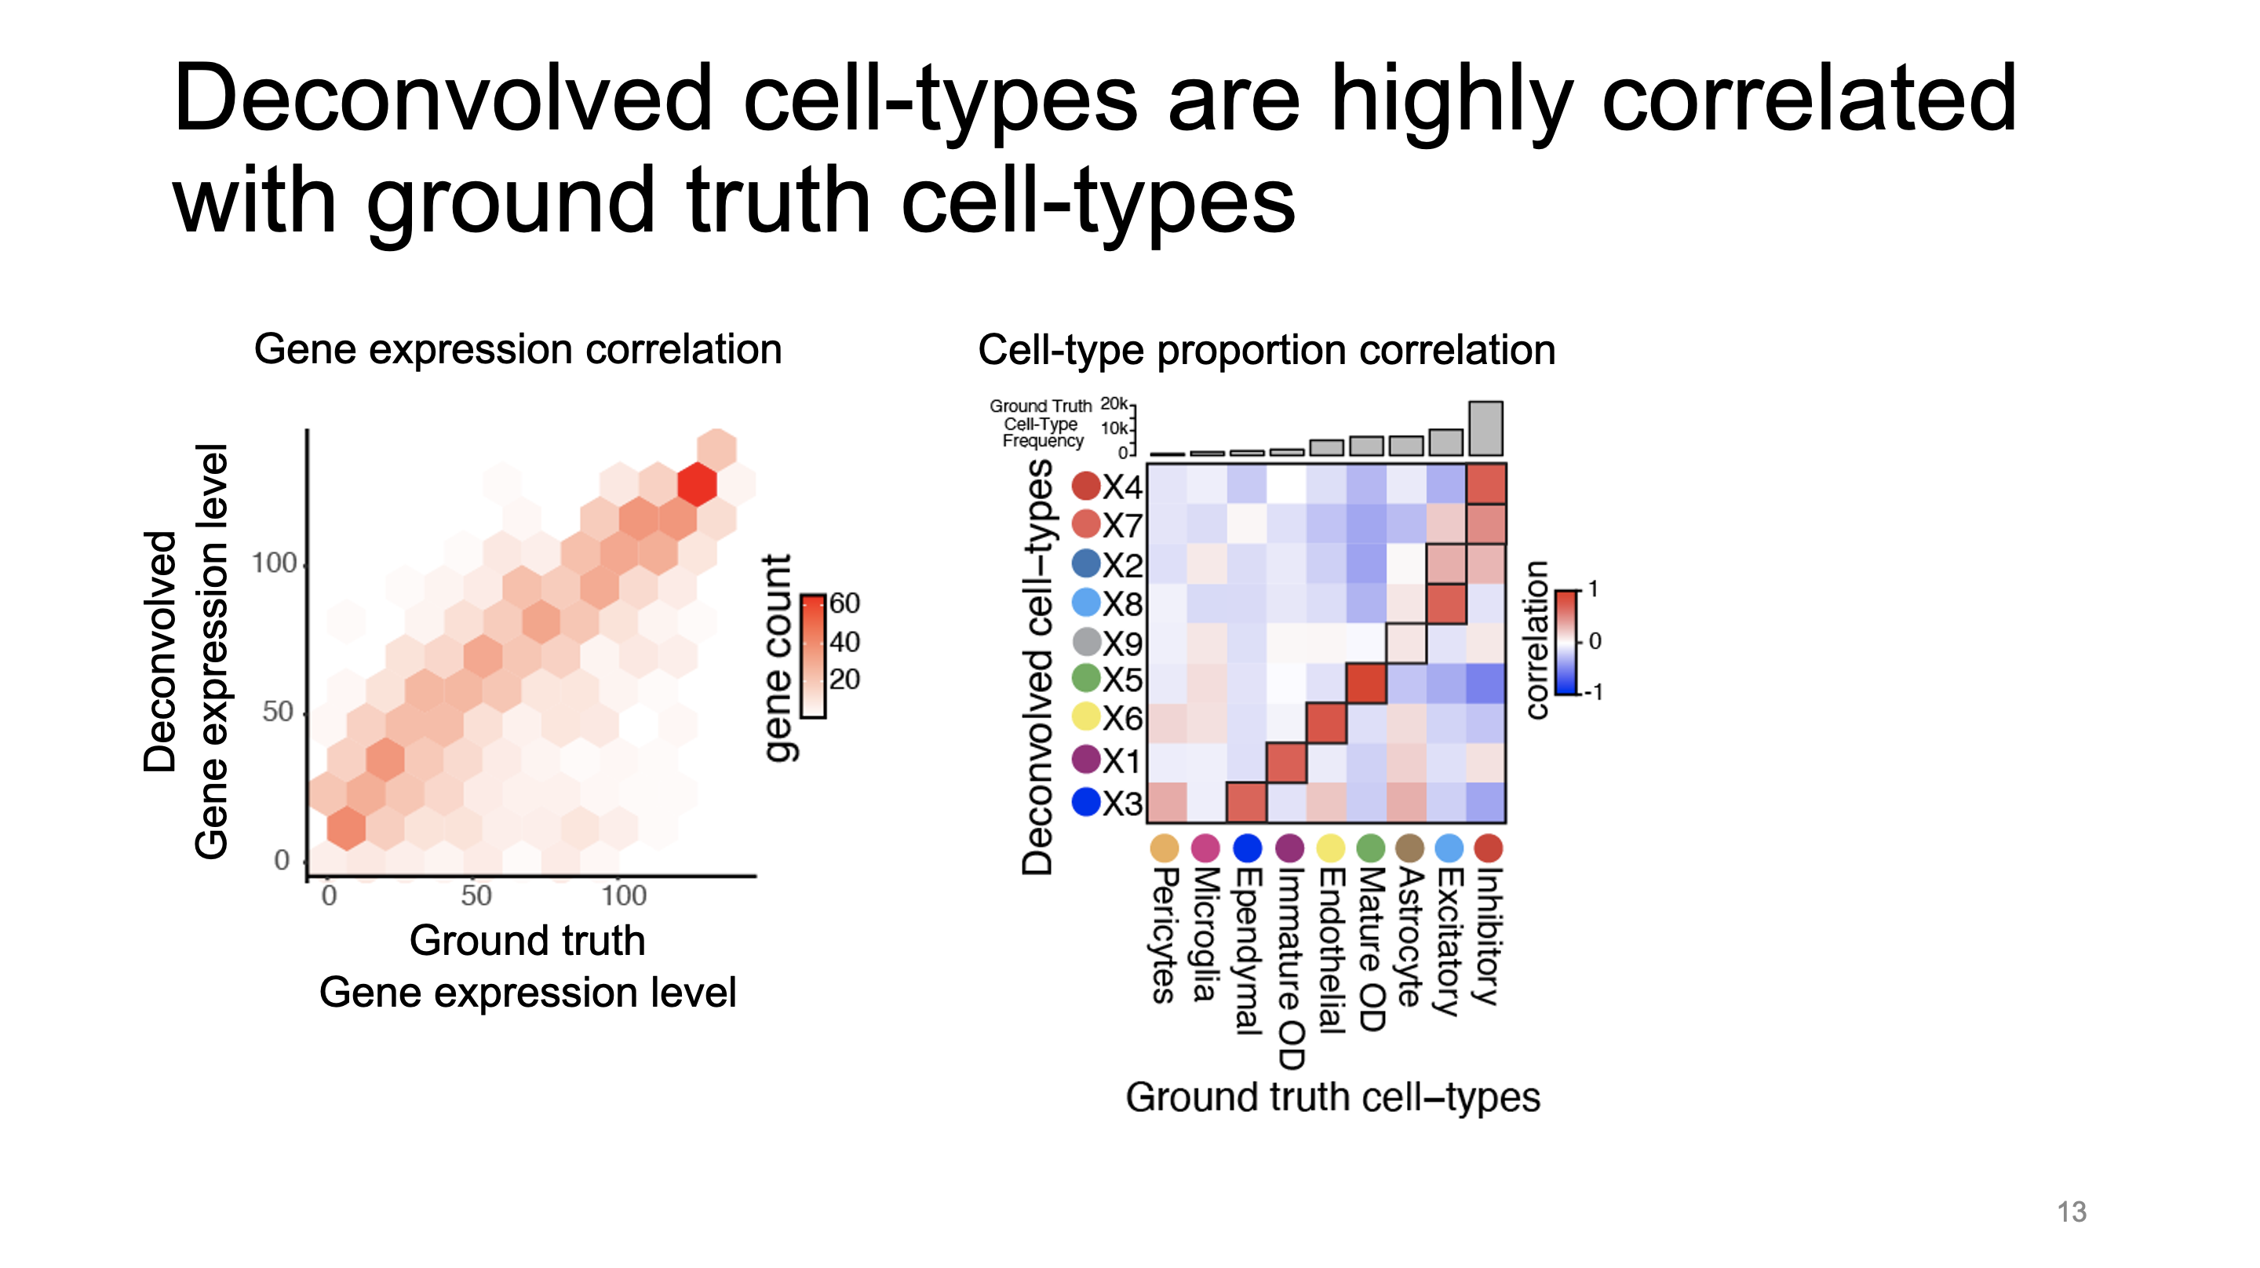
Notes:
Here are the correlations between deconvolved cell-type proportions and ground truth proportions and you can see that the deconvolved cell-types pair nicely with the ground truth cell-types in terms of their pixel proprotions.

Slide 47
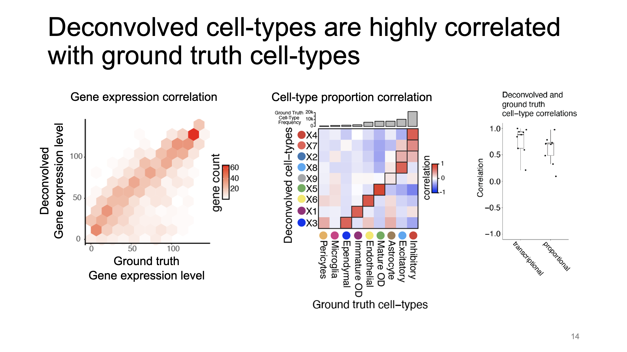
Notes:
And overall I can see that the correlations between the ground truth and deconvolved cell-types are high with respect to both their transcriptional profiles and pixel proportions.

Slide 48
Proof of concept – conclusions
STdeconvolve cell-type transcriptional profiles are highly correlated with MPOA ground truth cell-types
STdeconvolve accurately deconvolves cell-type pixel proportions in simulated MPOA ST pixels

Slide 49
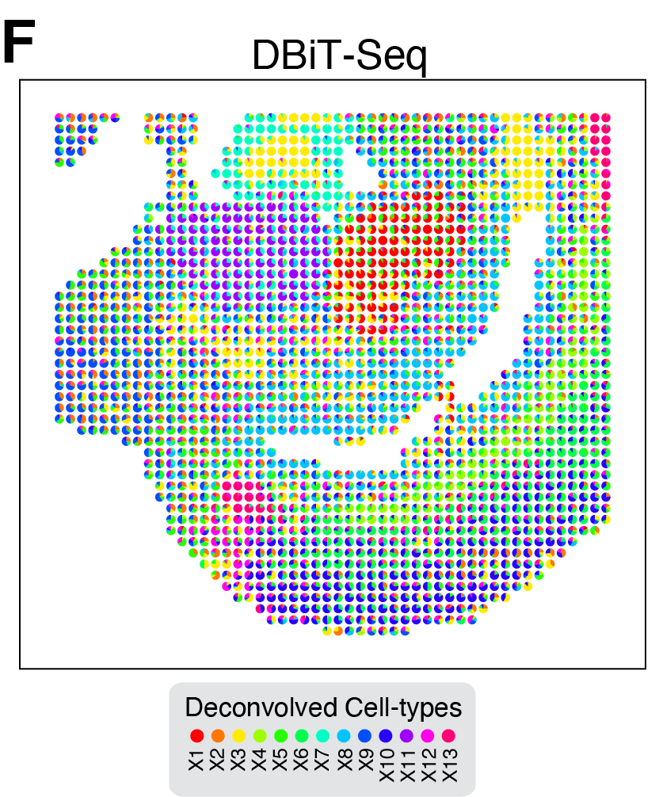
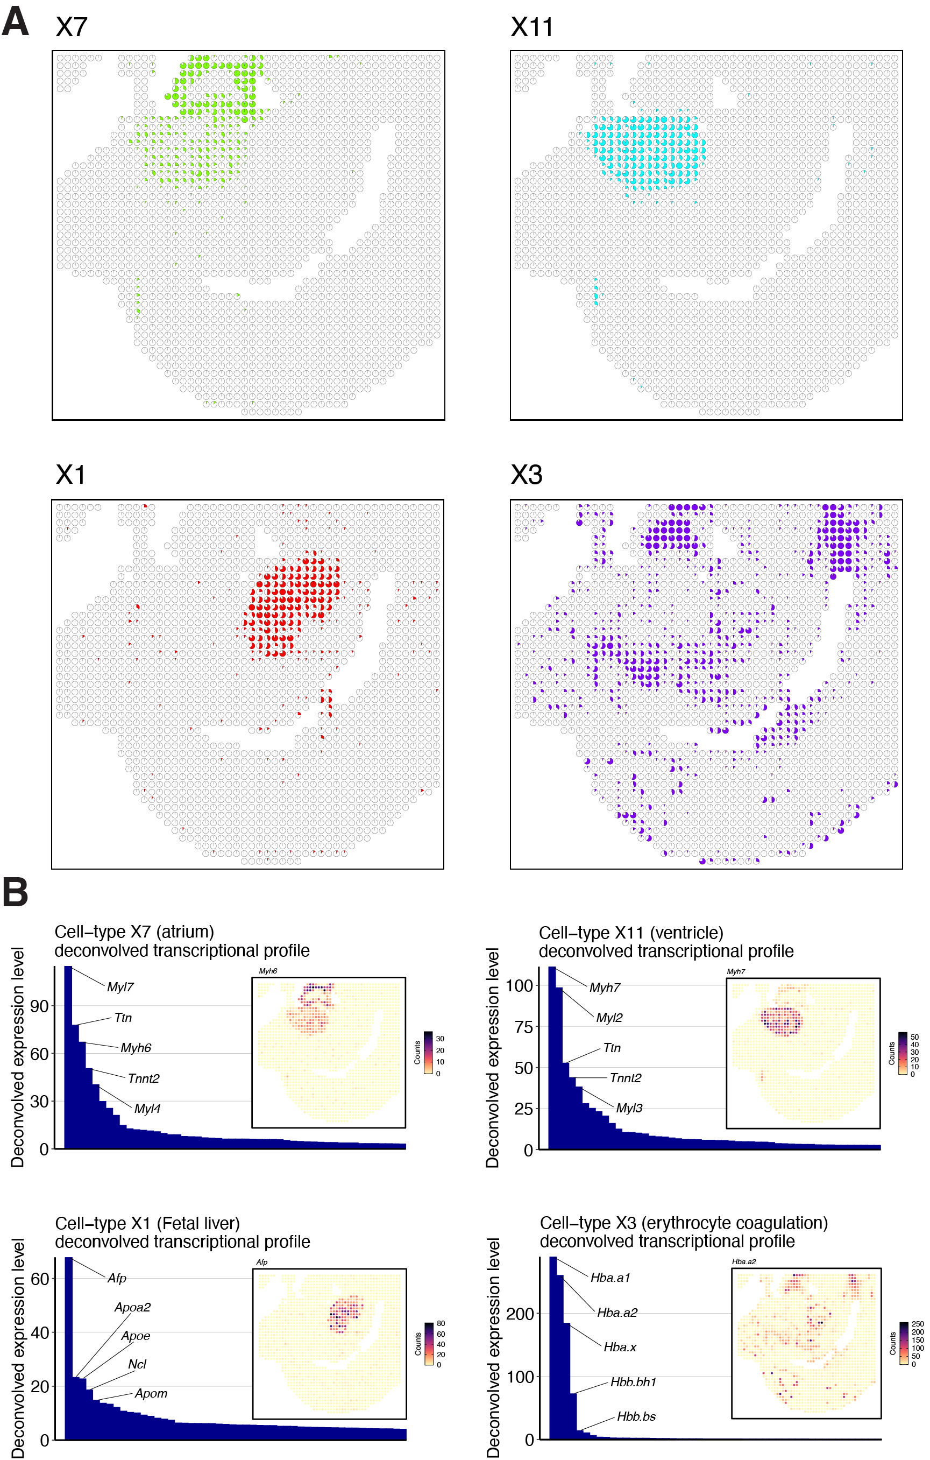
STdeconvolve is applicable across diverse ST datasets resolution and technologies
atrium
ventricle
How can I validate that these deconvolved cell-types are what I say they are?
fetal liver
erythrocytes
Resolution: 25 µm²
E11 mouse embryo lower body

Slide 50
STdeconvolve is applicable across diverse ST datasets resolution and technologies
Deconvolved transcriptional profiles contain key marker genes
atrium
ventricle
fetal liver
erythrocytes
Resolution: 25 µm²
E11 mouse embryo lower body

Slide 51
Identifying optimal number of cell-types for deconvolution
How do I decide on the number of cell-type K?
Notes:
This dataset had 260 pixels and we filtered for 255 overdispersed genes.
We next had to determine the optimal number of cell-types to deconvolve in the model.
We can use perplexity, which basically says how well the model represents the data, where a lower perplexity is better.
As we increase K, the perplexity decreases, indicating that the model is doing a better job representing the underlying variation in the data.
But eventually, perplexity starts to flatten out.
As K increases, some deconvolved cell-types represent low proportions in the pixels. This indicates that these cell-types are picking up small amounts of variation in the data, but these cell-types likely are no longer that informative because they aren’t capturing as much information in the data. We can use this metric to help set an upper bound on K.
Here, we find that 12 cell-types could be an informative number of cell-types to deconvolve

Slide 52
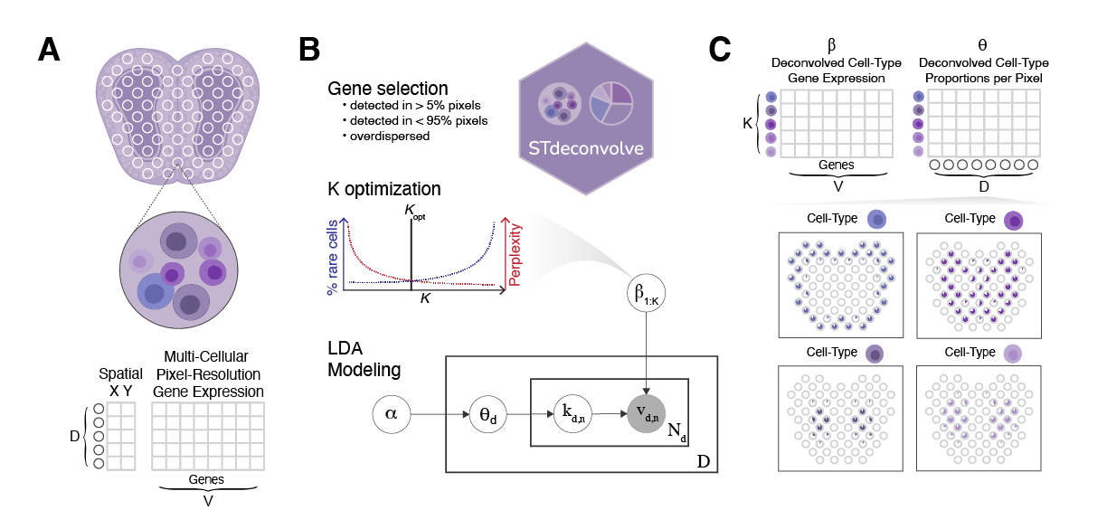
Identifying optimal number of cell-types for deconvolution
What happens to θ as K increases?
260 pixels x 255 over dispersed genes
Number “low proportion” cell-types
perplexity
12
Number of cell-types to deconvolve
Notes:
With more topics, many will have low probability. A lot may be low in most or all pixels, which could indicate that this topic is not picking up any additional useful biological information.
Can use this to help place an upper bound on our choice of K

Slide 53
Any limitations of STdeconvolve (and LDA for that matter?)

Slide 54
Any limitations of STdeconvolve (and LDA for that matter?)
Assumptions:
Few cell-types in each pixel
Cell-type proportions are heterogeneous across pixels
Assumes that there are multiple genes informative of each underlying cell-type and cell-types are transcriptionally distinct
Cannot differentiate between cell-types that cannot be distinguished through distinct differences in proportional gene expression such as volume or morphology
LDA requires many documents to be effective. It’s accuracy may be compromised if too few pixels
Notes:
What would happen if these assumptions failed?
Think about the push and pull between alpha, beta, theta. Would not be able to have sparse concentrated components, or find distinct topics. Alpha would be large and we likely would not converge.

Slide 55
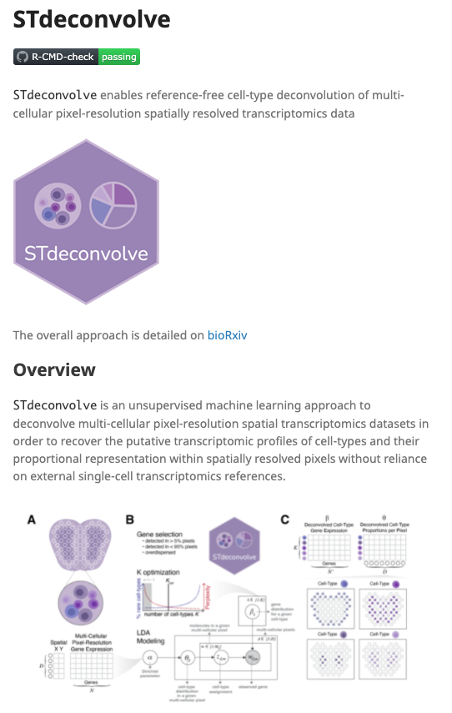
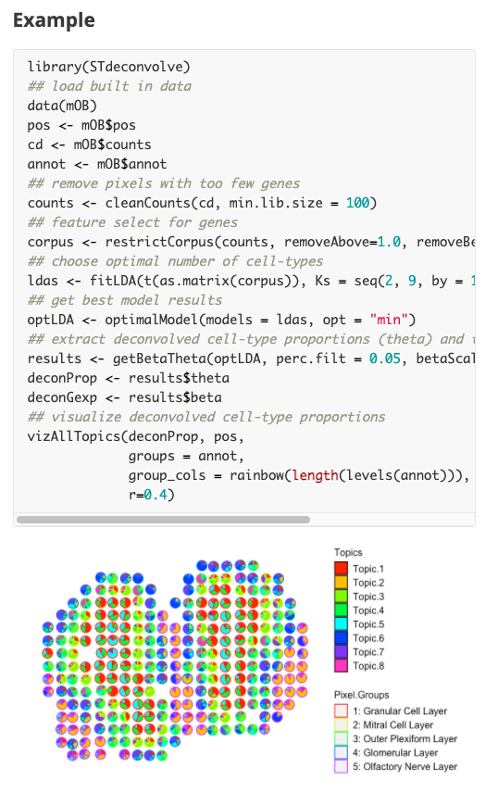
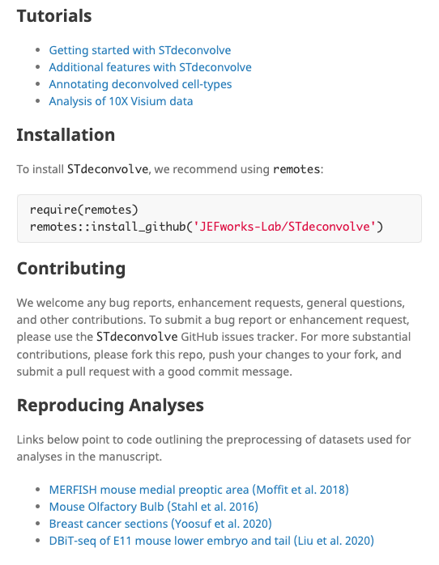
https://jef.works/STdeconvolve/
Notes:
For those who are interested,
STdeconvolve is available as an R package for download and provide example data and tutorials to help users get started.
I encourage you to try it out, and I welcome any suggestions for improvement. Just submit an issue on the GitHub page

Slide 56
Explore some data and questions
MOB test dataset
Try to fit LDA models
Visualize cell-types
What are they? Can we identify them?

